Slide 1

PERFORMANCE METRICS

Slide 2

“The Trend is your
friend except at
the end where it
bends.” - Ed Seykota

Slide 3

Introduction to Indicators
Mathematical Calculations
Measure Momentum, Zones, Strength
Identify Levels to be Targeted
Enhance Chart Analysis
Notes:
Purpose of Indicators:
Measure Momentum, Volatility, Zones, and Market Strength
Identify Key Levels for Trading Decisions
Types of Indicators:
1) Lagging Indicators
Calculation on Historical Data: Derive results from past market information
Common Examples: Moving Averages, MACD, Bollinger Bands
Use Cases: Trend confirmation and identification
2) Leading Indicators
Predict Future Possibilities: Anticipate potential market moves
Common Examples: RSI(Can be both lagging and leading), Stochastic Oscillator, Ichimoku Cloud
Use Cases: Early trend signals and reversal indications
Selecting Indicators:
Strategy Alignment: Choose indicators aligning with trading strategies
Contextual Analysis: Consider broader market context
Indicators and Decision-making:
Enhanced Analysis: Indicators supplement chart analysis
Validation Needed: Combine indicator signals for robust insights

Slide 4
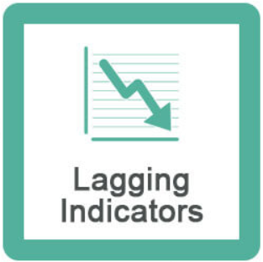
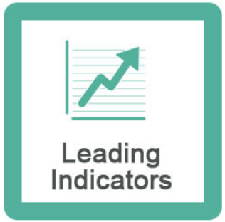
Introduction to Indicators
Types of Indicators
Historical Data
Moving Averages
Predict Future
Stochastic
Notes:
Purpose of Indicators:
Measure Momentum, Volatility, Zones, and Market Strength
Identify Key Levels for Trading Decisions
Types of Indicators:
1) Lagging Indicators
Calculation on Historical Data: Derive results from past market information
Common Examples: Moving Averages, MACD, Bollinger Bands
Use Cases: Trend confirmation and identification
2) Leading Indicators
Predict Future Possibilities: Anticipate potential market moves
Common Examples: RSI(Can be both lagging and leading), Stochastic Oscillator, Ichimoku Cloud
Use Cases: Early trend signals and reversal indications
Selecting Indicators:
Strategy Alignment: Choose indicators aligning with trading strategies
Contextual Analysis: Consider broader market context
Indicators and Decision-making:
Enhanced Analysis: Indicators supplement chart analysis
Validation Needed: Combine indicator signals for robust insights
Indicators
Indicators are used to measure momentum, volatility, zones, strength of market or levels for trading.
Types of Indicators
1) Lagging Indicators: These indicators do mathematical calculations on previous market data, and derive a result.
2) Leading Indicators: These indicators predict future possibilities.

Slide 5
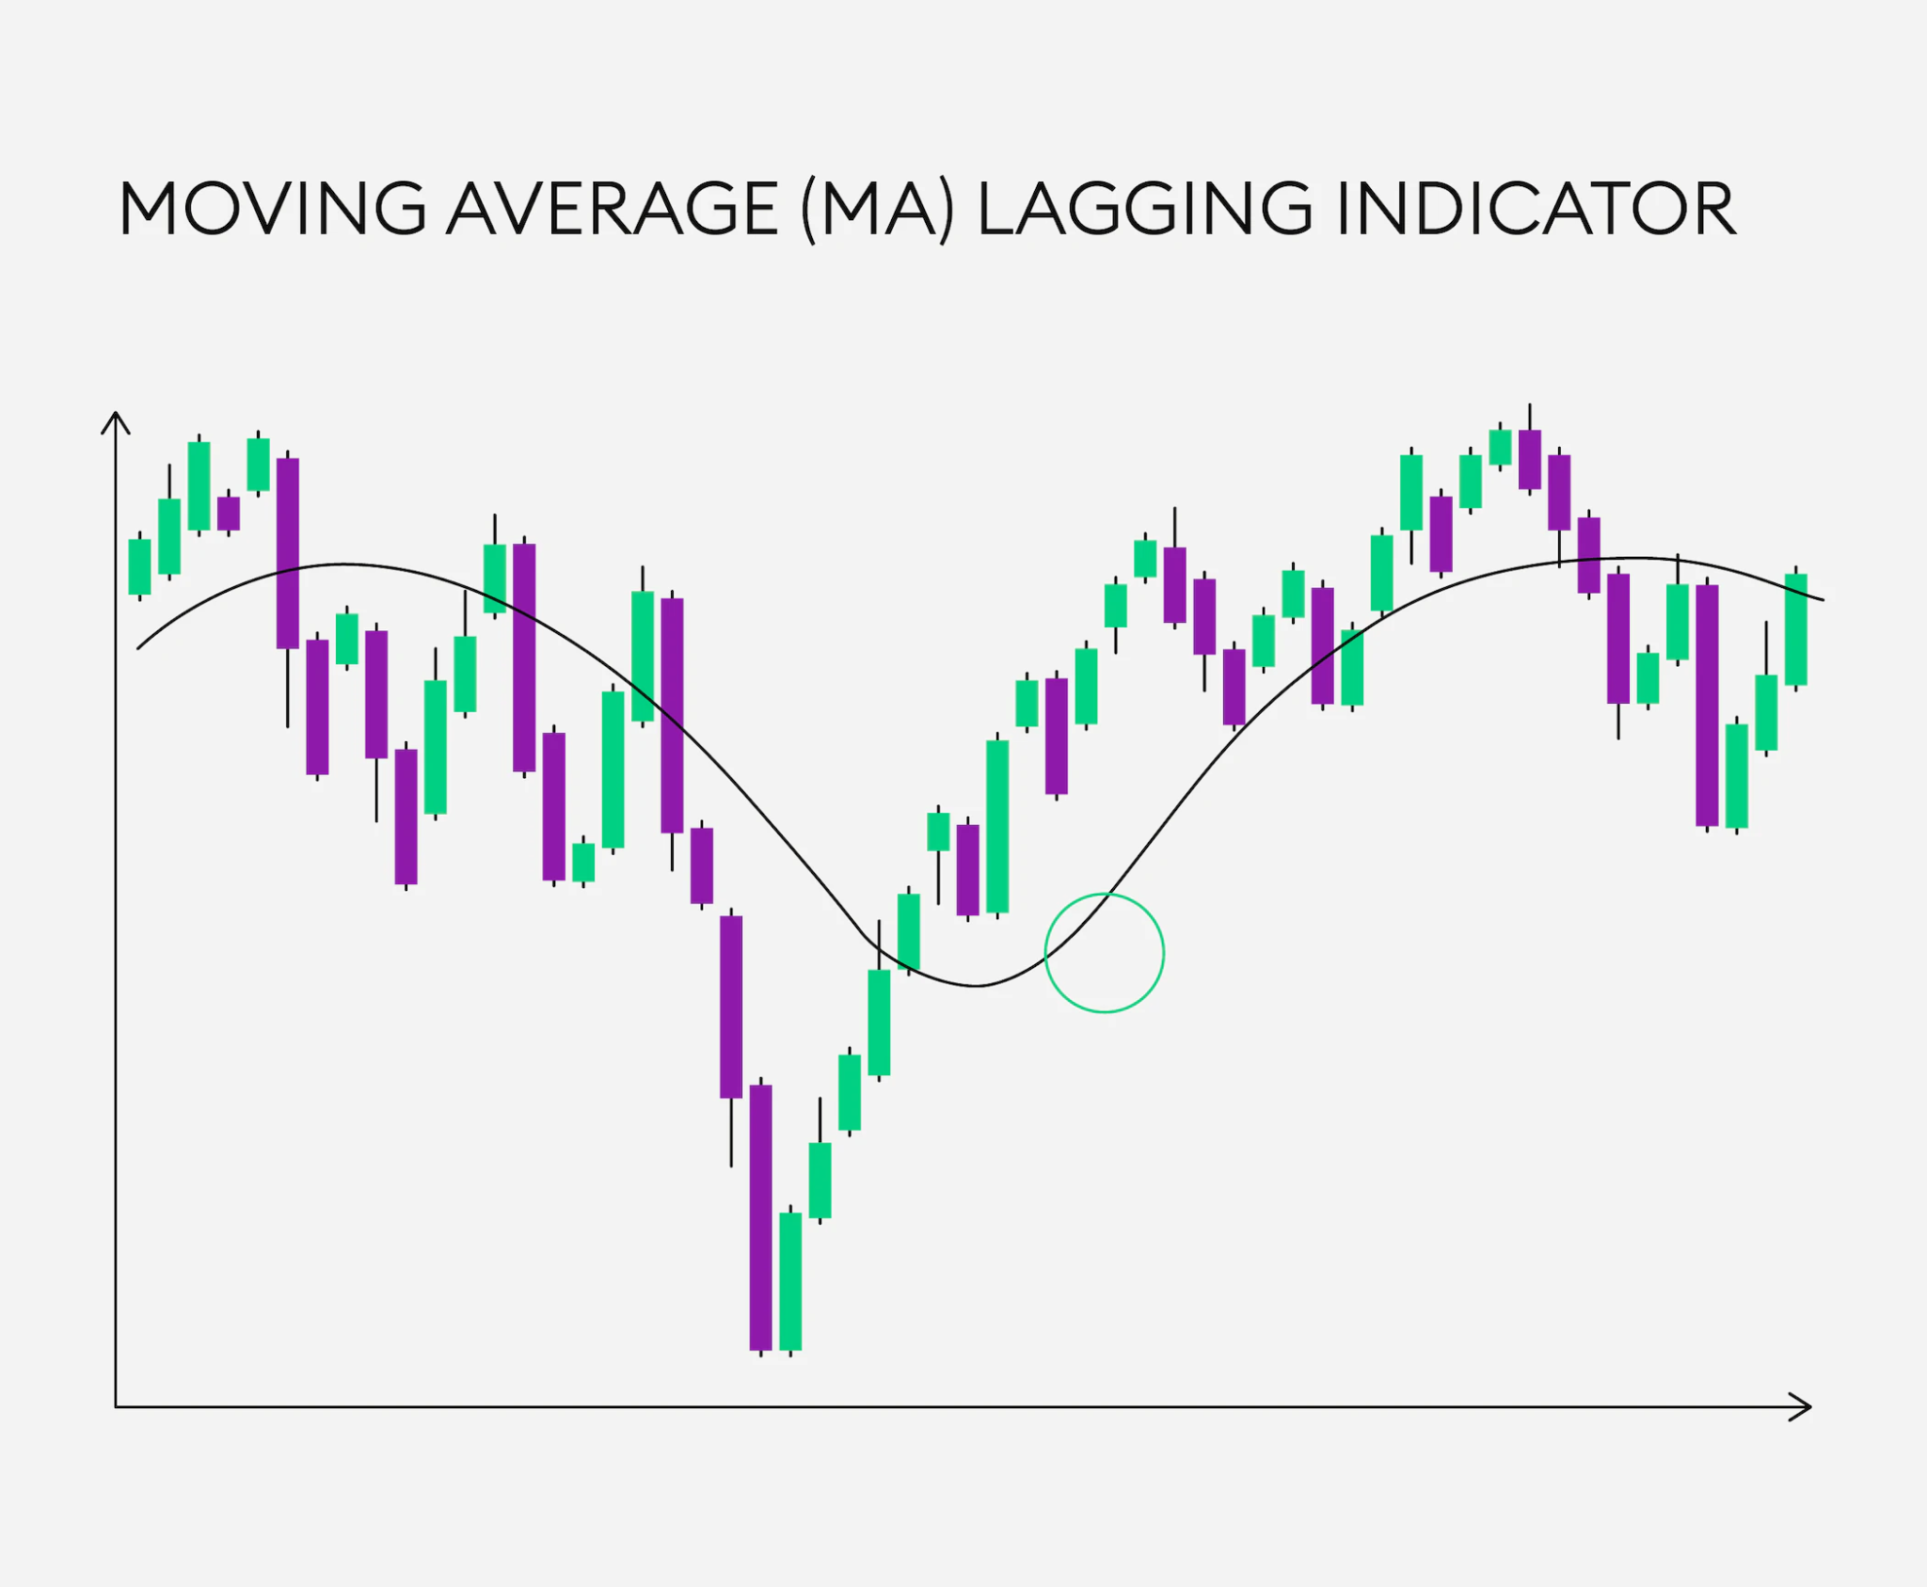
Lagging Indicator - Moving Averages
Price Dependent Indicator
Historical Price Data
Smooth Flow
Trend Direction, Reversals
Calculation:
Average of Past n Candles
Line Along Candlesticks
Notes:
1) Moving Averages: It is a price dependent indicator. Moving averages takes average of previous n candles, normally 5-9, and draws a line along the candle sticks. It has two major types:
a)Simple Moving Average (SMA)
Formula, SMA = (A1+A2+….+An)/n
Here n = number of total periods
So, Simple Moving Average is basically a flat average of Open and Close prices. All candles are given the same weightage while calculating it.
Normally candles in SMA are 9,13,21,55,100,200
b)Exponential Moving Average (EMA)
Formula, EMA = Price(t)*k + EMA(y)*(1-k)
More importance will be given to recent candles/ price action.
t = Price today
y = Price yesterday
Why EMA is better than SMA? because in EMA recent candles are given more importance.
Price Dependent Indicator:
Utilizes historical price data for analysis
Offers insights into trend direction and potential reversals
Calculation Process:
Takes average of past n candles (typically 5-9)
Plots a line along candlesticks on the chart

Slide 6
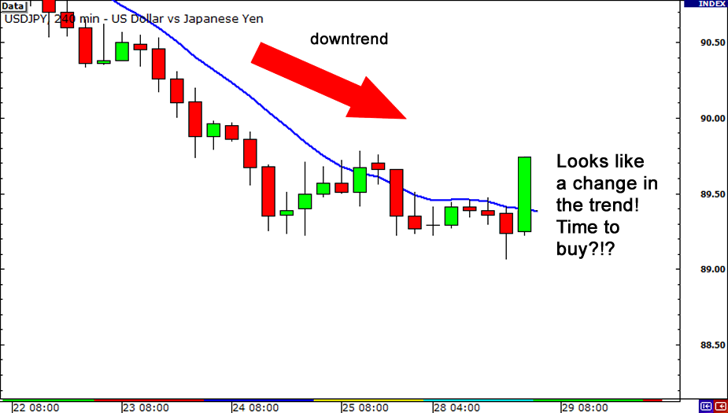
Use of Moving Averages
Find the Trend:
Uptrend, Downtrend, Sideways
Direction:
EMA vs. Candles
Above EMA: Uptrend
Below EMA: Downtrend
Support and Resistance:
EMA Role
Downtrend: EMA Resists
Uptrend: EMA Supports
Notes:
1.Find the trend (whether the trend is uptrend, downtrend or side trend - which doesn’t have up or down angles).
2.Direction of Market (for example for 200 candles, if the candle sticks remained above the EMA line then it’s uptrend, if stays below EMA then it’s downtrend).
3.Help us find support and resistance (In case of downtrend it acts as resistance, e.g. when bulls are pushing the price above then the EMA line will act as resistance. If it’s an uptrend, and bears are trying to lower the price then EMA acts as resistance line).
1) Identifying the Trend
Trend Determination:
Recognize uptrend, downtrend, or sideways movement
Moving averages aid in deciphering market direction
2) Assessing Market Direction
EMA as Trend Indicator:
EMA positioning relative to candlesticks
E.g., Above EMA: Uptrend, Below EMA: Downtrend
3) Support and Resistance Discovery
Support and Resistance:
EMA acts as dynamic support or resistance
Downtrend: EMA as resistance; Uptrend: EMA as support
Real-world Scenarios
Uptrend Scenario:
Bulls pushing price higher
EMA acts as a support level
Downtrend Scenario:
Bears attempting to lower price
EMA serves as a resistance level
Advantages of Moving Averages
Clarity in Market Conditions:
Moving averages clarify trend status
Help determine potential entry and exit points
Flexibility in Strategy:
Support and resistance insights assist in planning trades
Suitable for various trading styles

Slide 7
Types of Moving Averages
Simple Moving Average (SMA)
Exponential Moving Average (EMA)
SMA = (A1 + A2 + … + An) / n (n = No. of total periods)
All candles hold equal weightage/importance.
Common Periods:
9, 13, 21, 55, 100, 200
Q. Why EMA is better than SMA?
EMA = Price(t) * k + EMA(y) *(1 - k) (t=price today ; y=price yesterday)
Recent candles hold more importance.
Offers enhanced sensitivity to recent price changes.
Ans. In EMA recent candles are given more importance.
Notes:
a)Simple Moving Average (SMA)
Formula, SMA = (A1+A2+….+An)/n
Here n = number of total periods
So, Simple Moving Average is basically a flat average of Open and Close prices. All candles are given the same weightage while calculating it.
Normally candles in SMA are 9,13,21,55,100,200
b)Exponential Moving Average (EMA)
Formula, EMA = Price(t)*k + EMA(y)*(1-k)
More importance will be given to recent candles/ price action.
t = Price today
y = Price yesterday
Why EMA is better than SMA? because in EMA recent candles are given more importance.
a) Simple Moving Average (SMA)
Formula: SMA = (A1 + A2 + … + An) / n
n = Number of total periods
All candles hold equal weightage
Common periods: 9, 13, 21, 55, 100, 200
b) Exponential Moving Average (EMA)
Formula: EMA = Price(t) * k + EMA(y) * (1 - k)
Recent candles hold more importance
Offers enhanced sensitivity to recent price changes

Slide 8
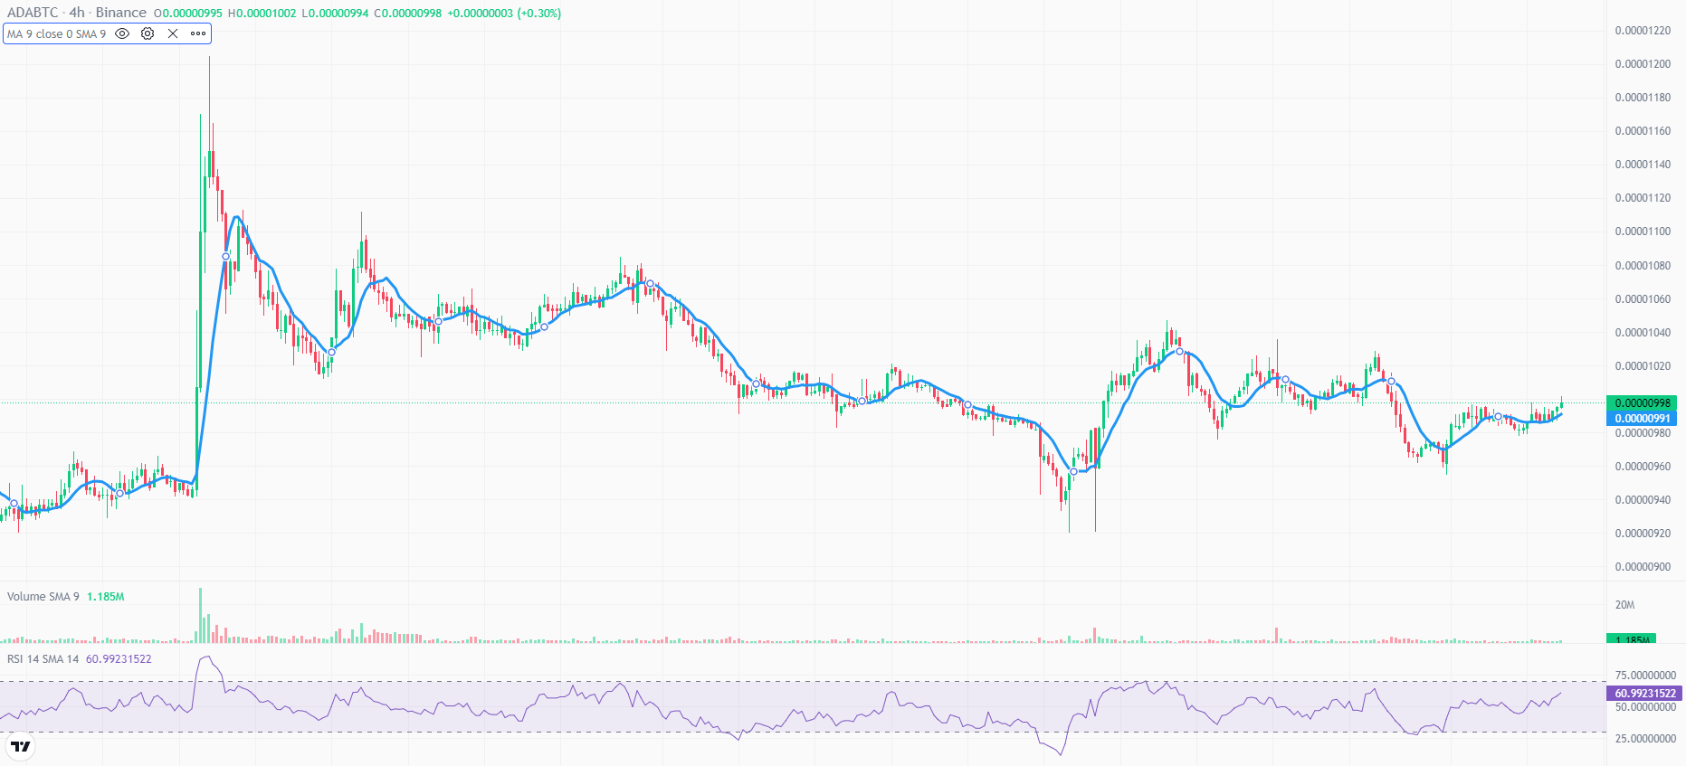
SMA - 9

Slide 9
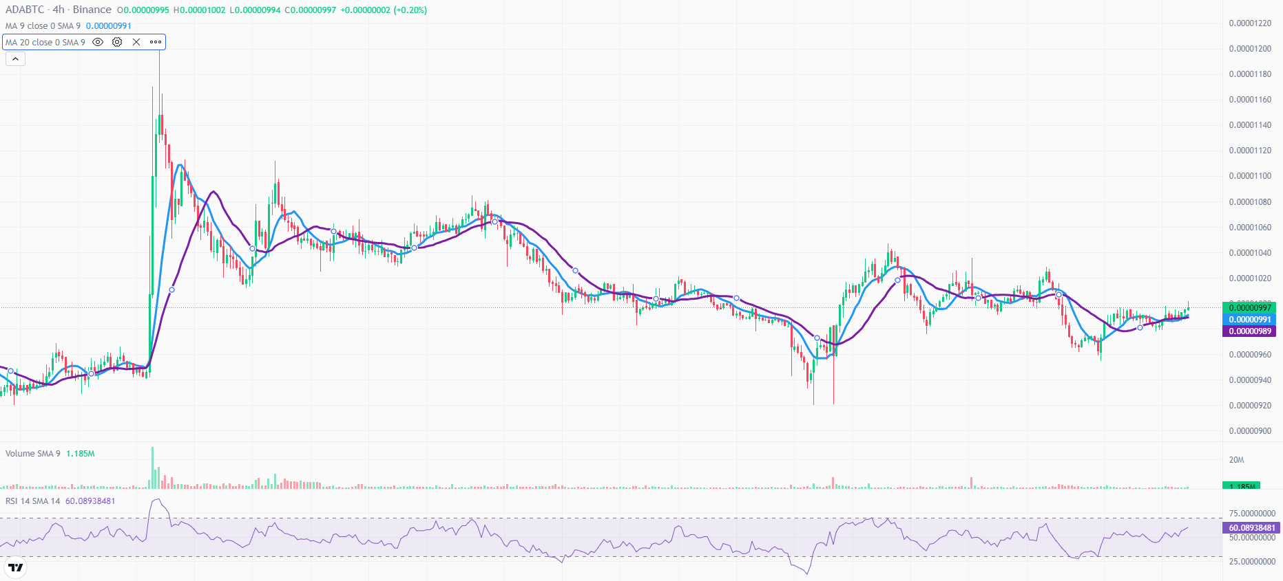
SMA - 9 vs 20

Slide 10
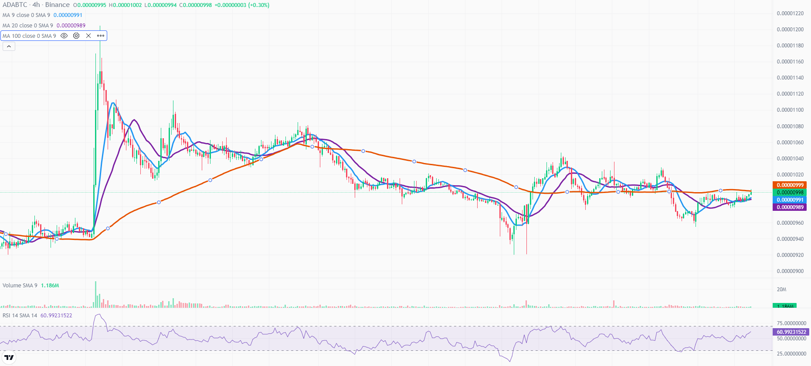
SMA - 9 vs 20 vs 100

Slide 11
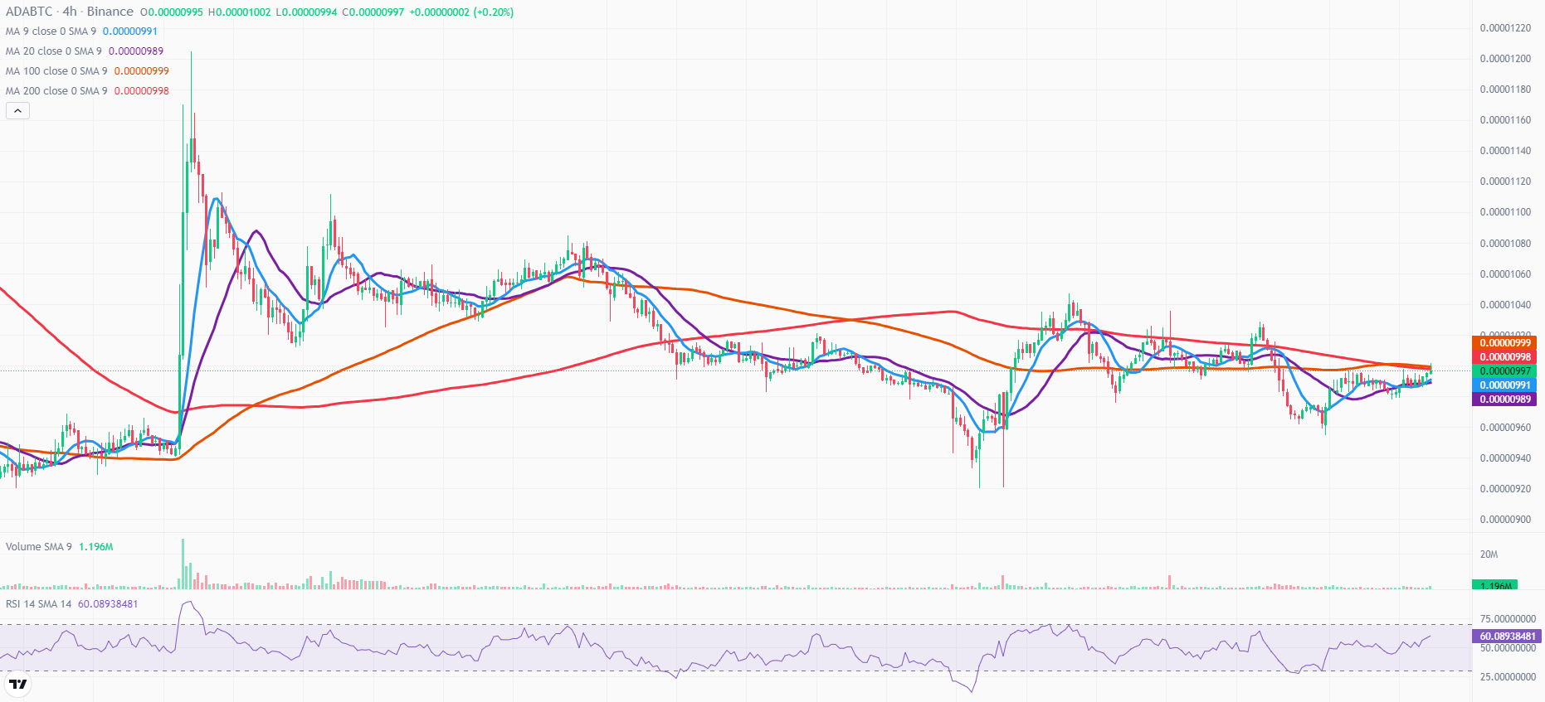
SMA - 9 vs 20 vs 100 vs 200

Slide 12
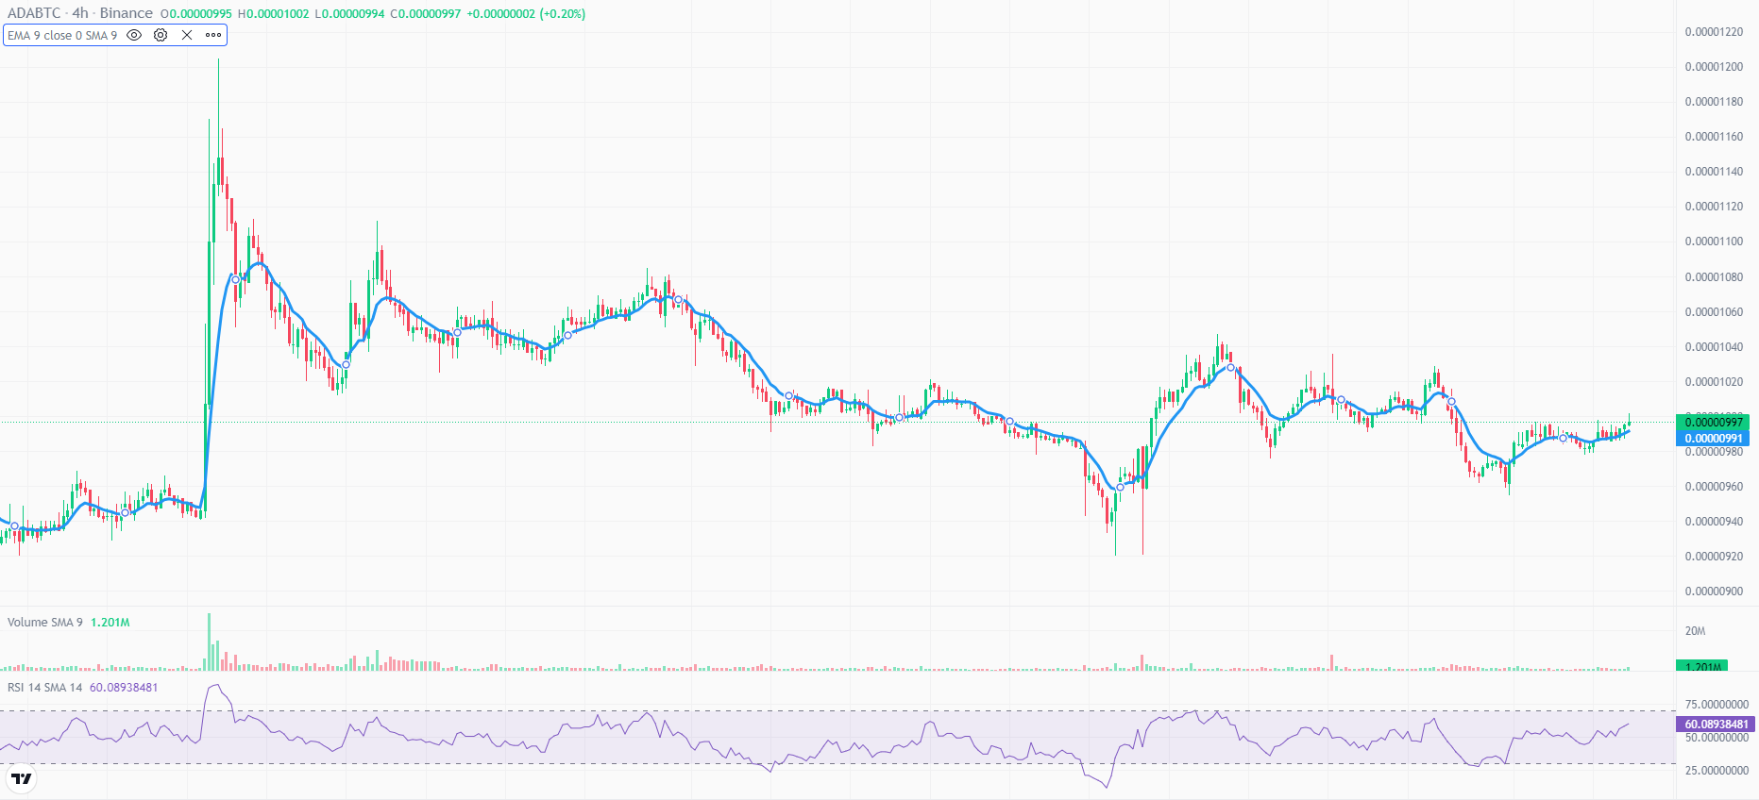
EMA - 9

Slide 13
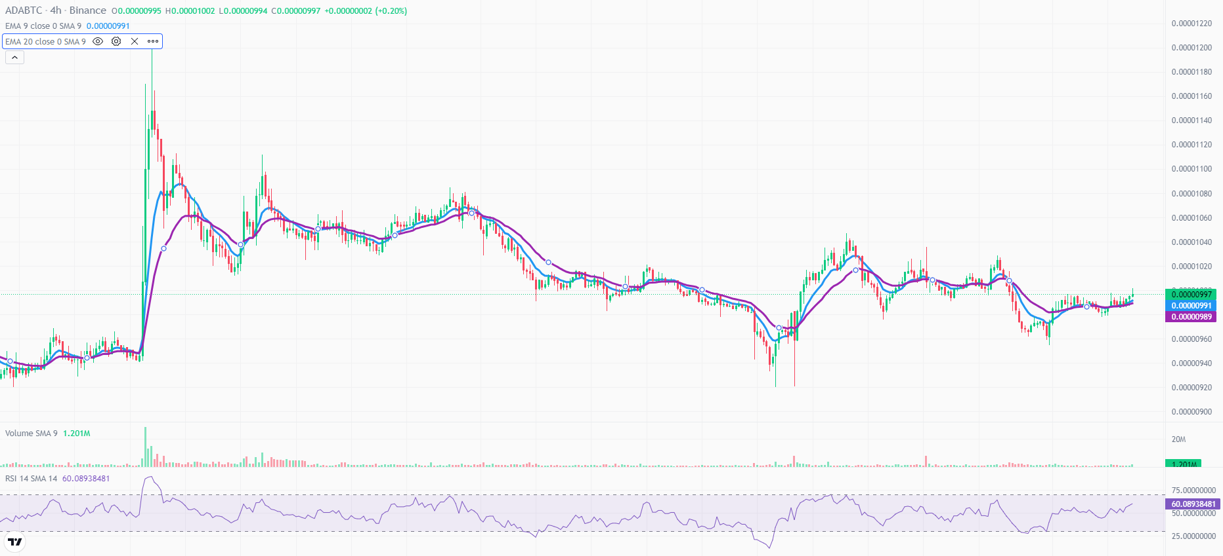
EMA - 9 vs 20

Slide 14
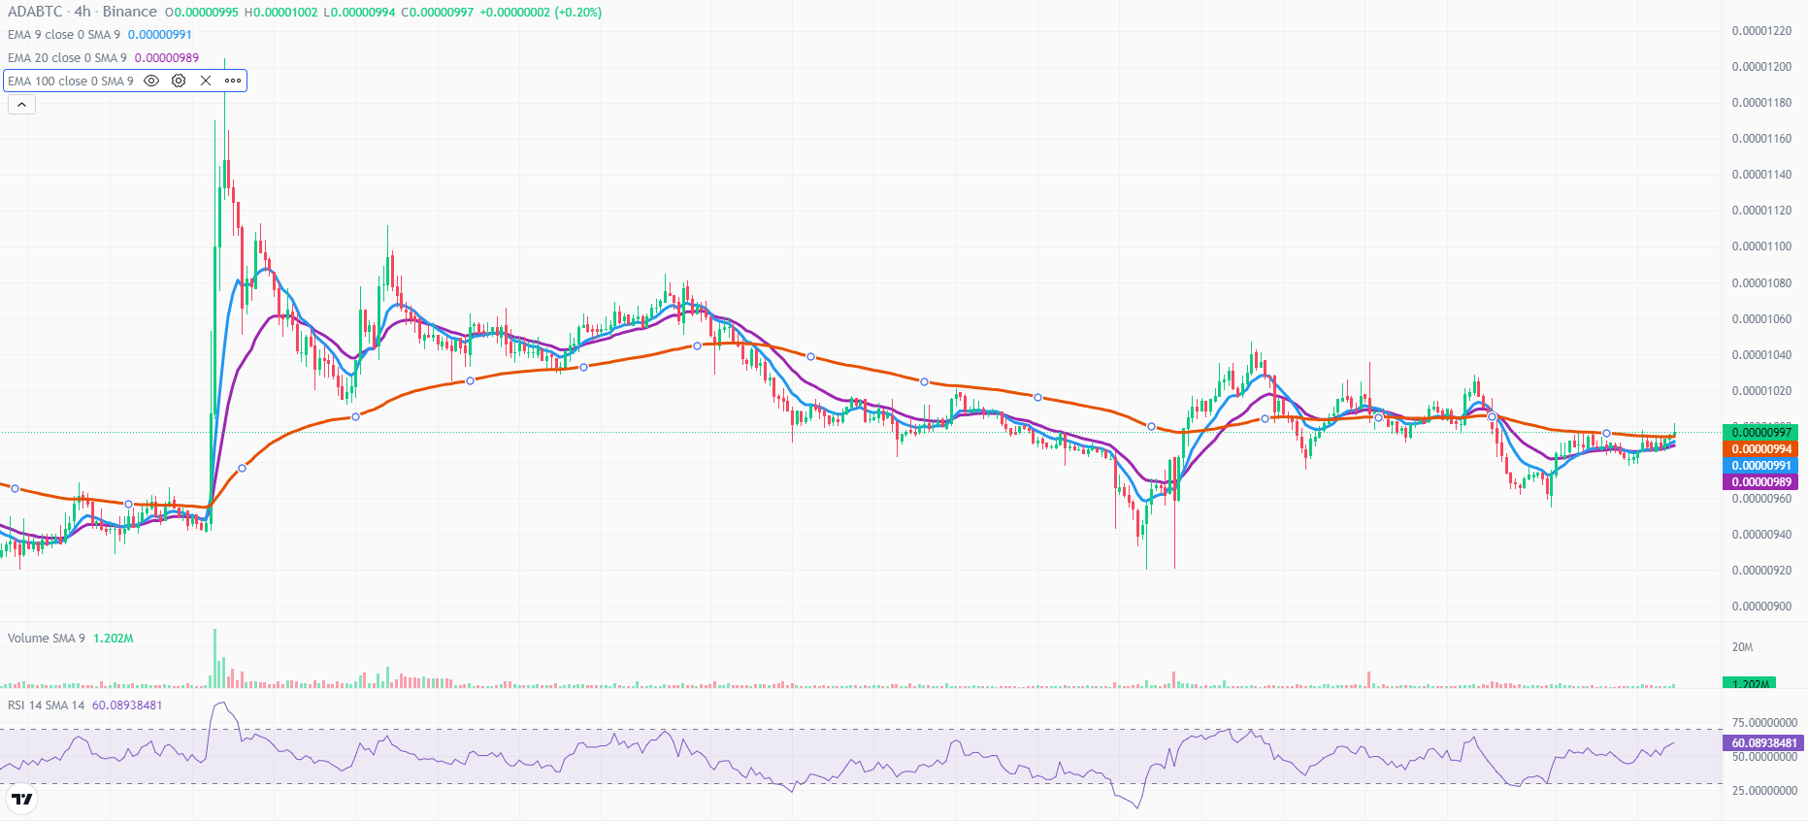
EMA - 9 vs 20 vs 100

Slide 15
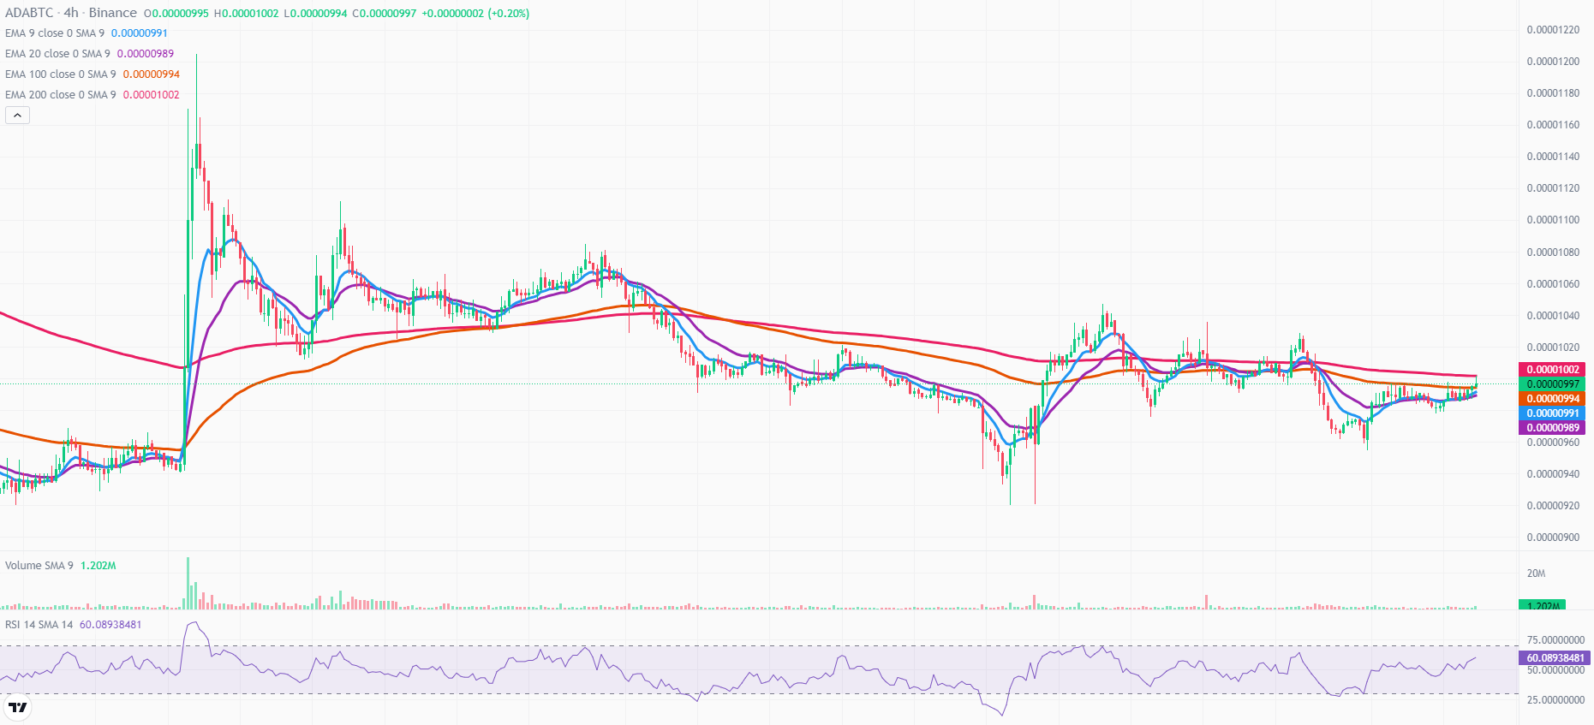
EMA - 9 vs 20 vs 100 vs 200

Slide 16
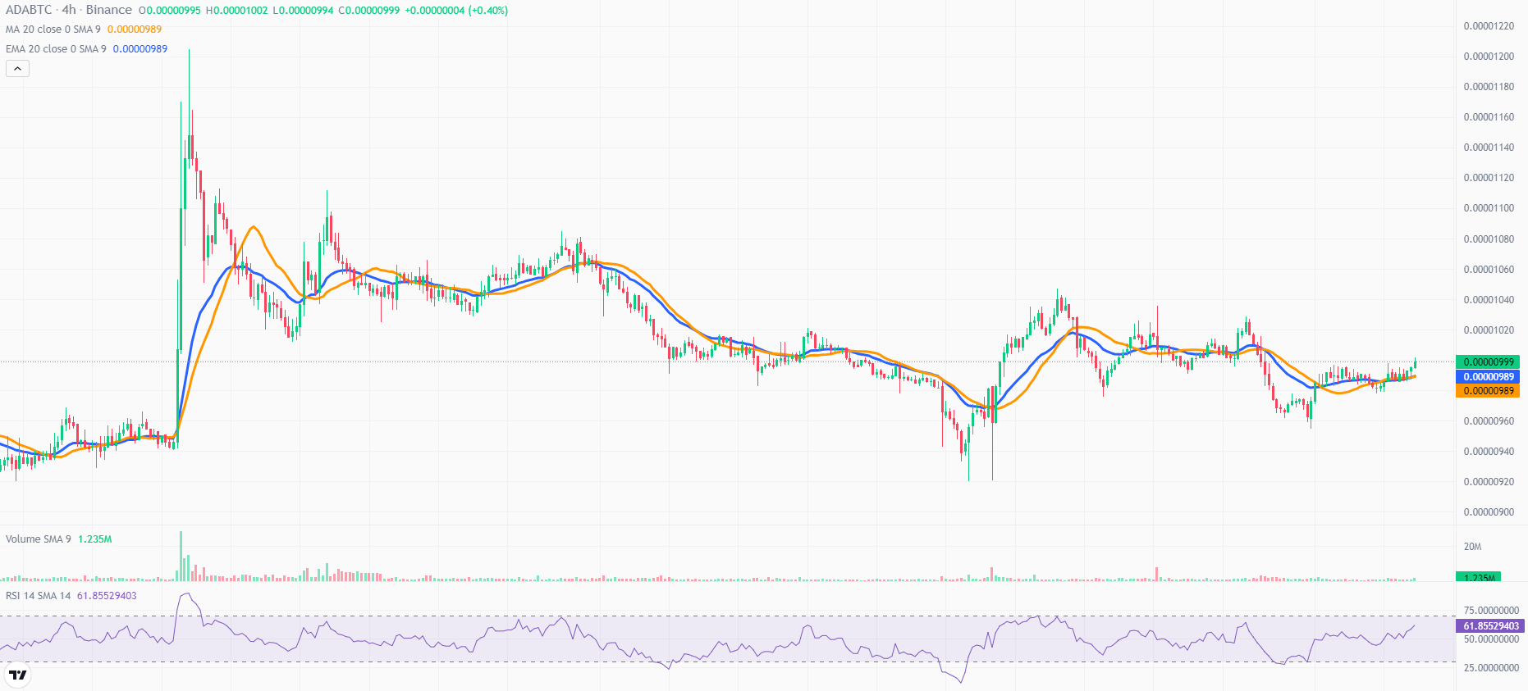
SMA 20 vs EMA 20

Slide 17
Methodologies in MA
Basic 2 EMA crossovers (e.g. 20 EMA and 50 EMA):
You can choose entry position based upon the cross overs as 20 EMA is fast moving and 50 EMA is slow moving.
Golden cross and Death cross strategy (50 EMA and 200 EMA):
When 50 EMA crosses 200 (after downtrend) down to up is called
golden cross, and when 50 EMA crosses 200 EMA, (after uptrend) from
up to down it’s called death cross.
Long-term 200 EMA strategy

Slide 18
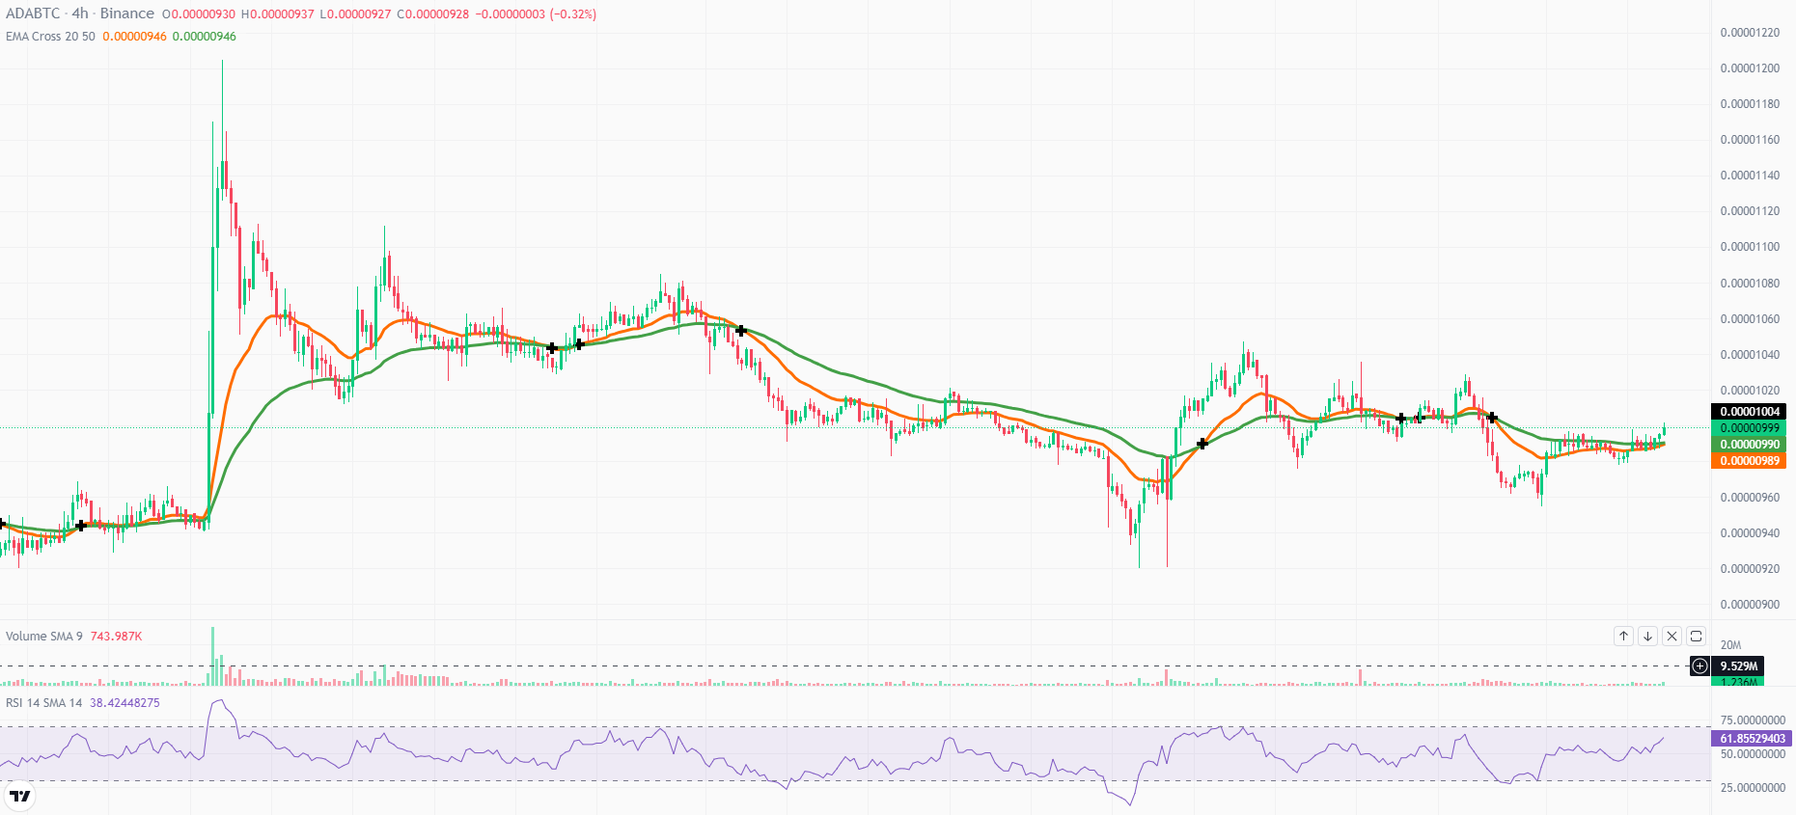
EMA Crossovers (20 vs 50)

Slide 19
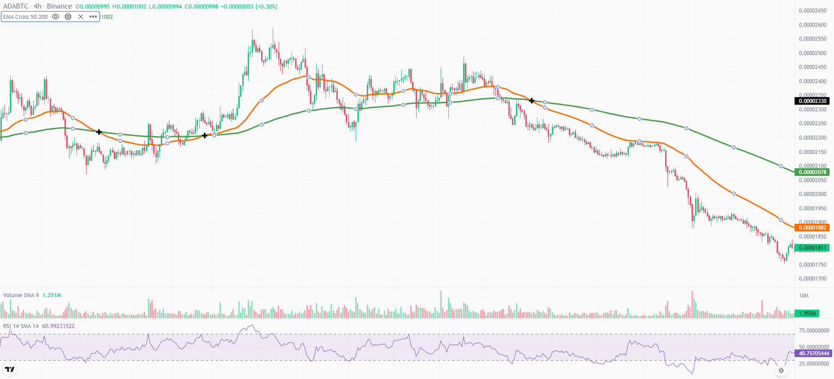
EMA Crossovers (50 vs 200)

Slide 20
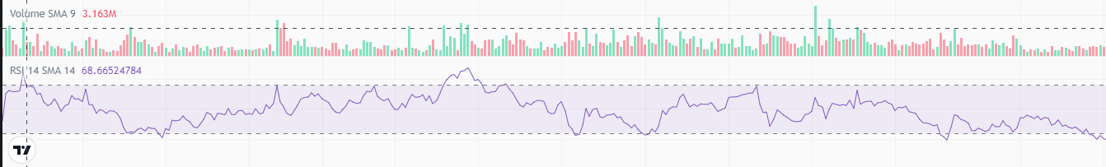
Relative Strength Index (RSI)
Analysis of current and historical Data.
Strength or weakness of assets
Based on the closing prices of recent trading periods
Momentum Indicator + Oscillator
e.g. Like driving a car on highway.

Slide 21
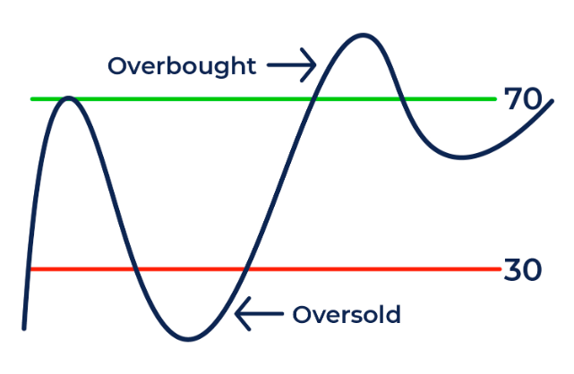
Relative Strength Index (RSI)
How to Read RSI?
Above upper line, in RSI will mean that it is overbought
Below lower line in RSI will mean that it is oversold.

Slide 22
Methodologies in RSI
At a basic level most people get at oversold region and transfer at overbought region.
Draw a line at 50 in RSI graph.
If most of the dealing is above the 50 line then it’s ‘bullish’ environment.
If most of the dealing is below 50 line then it’s ‘bearish’ environment.
One can look at trends on multiple time frames e.g. if trend is upwards in long time frame then asset evaluation variations in shorter time frame wouldn’t affect your position.

Slide 23
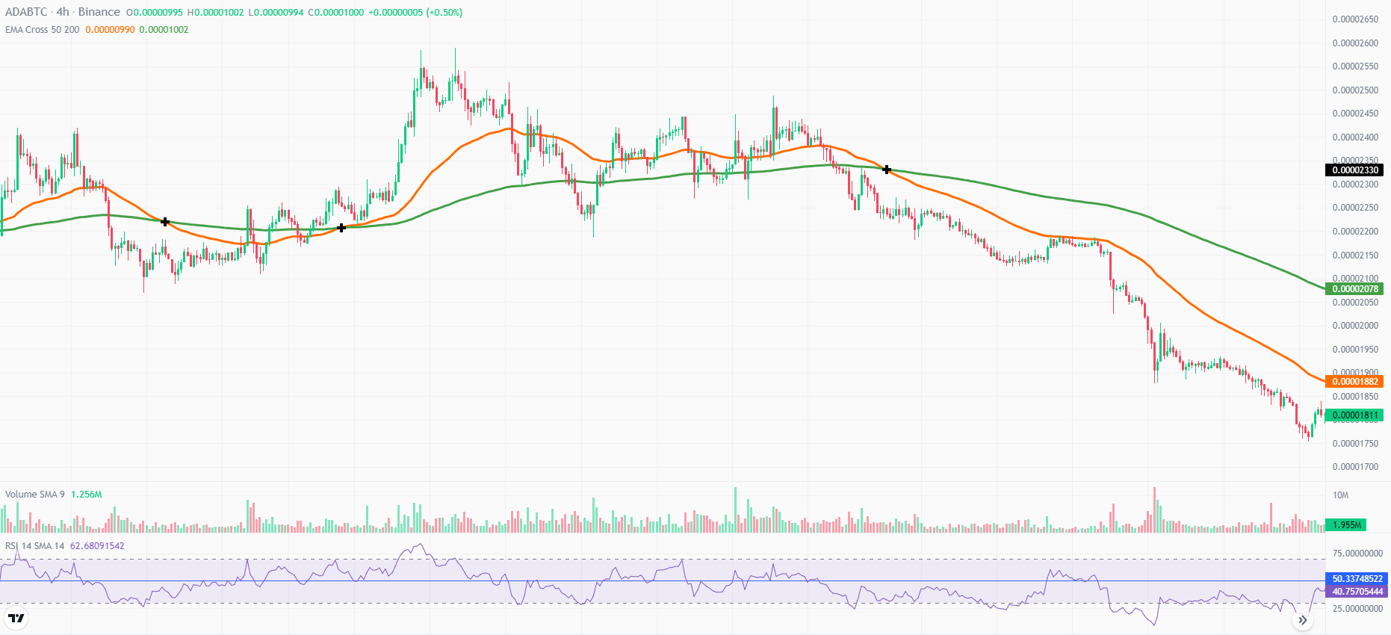
Methodologies in RSI

Slide 24

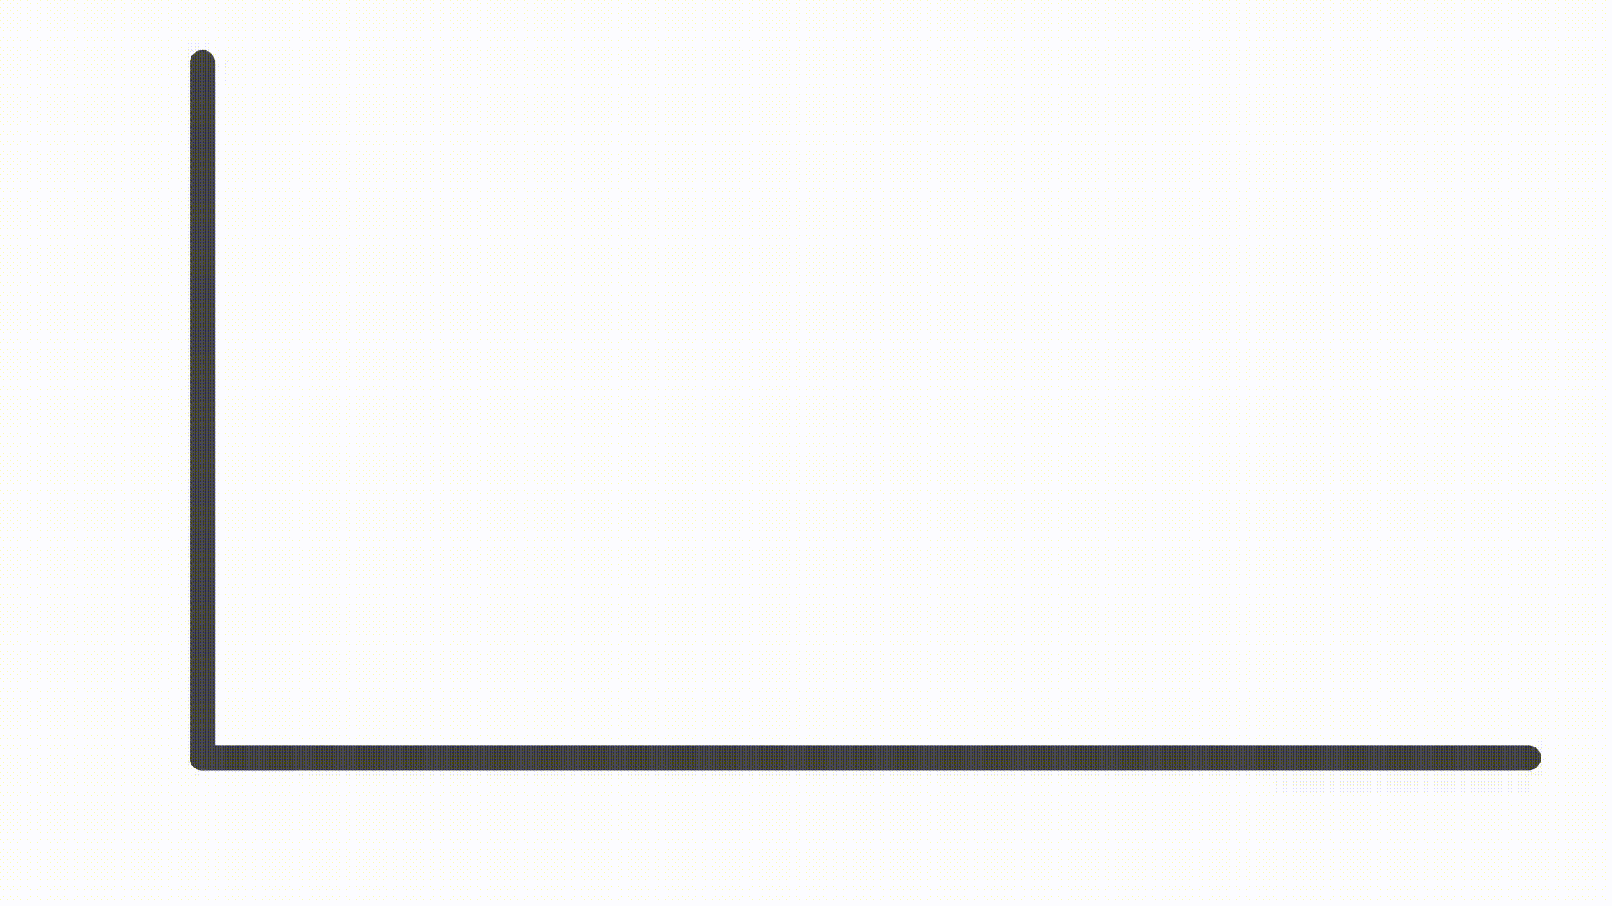
RSI Divergence
Demand ↑ ⇒ Supply ↓
Demand ↓ ⇒ Supply ↑

Slide 25
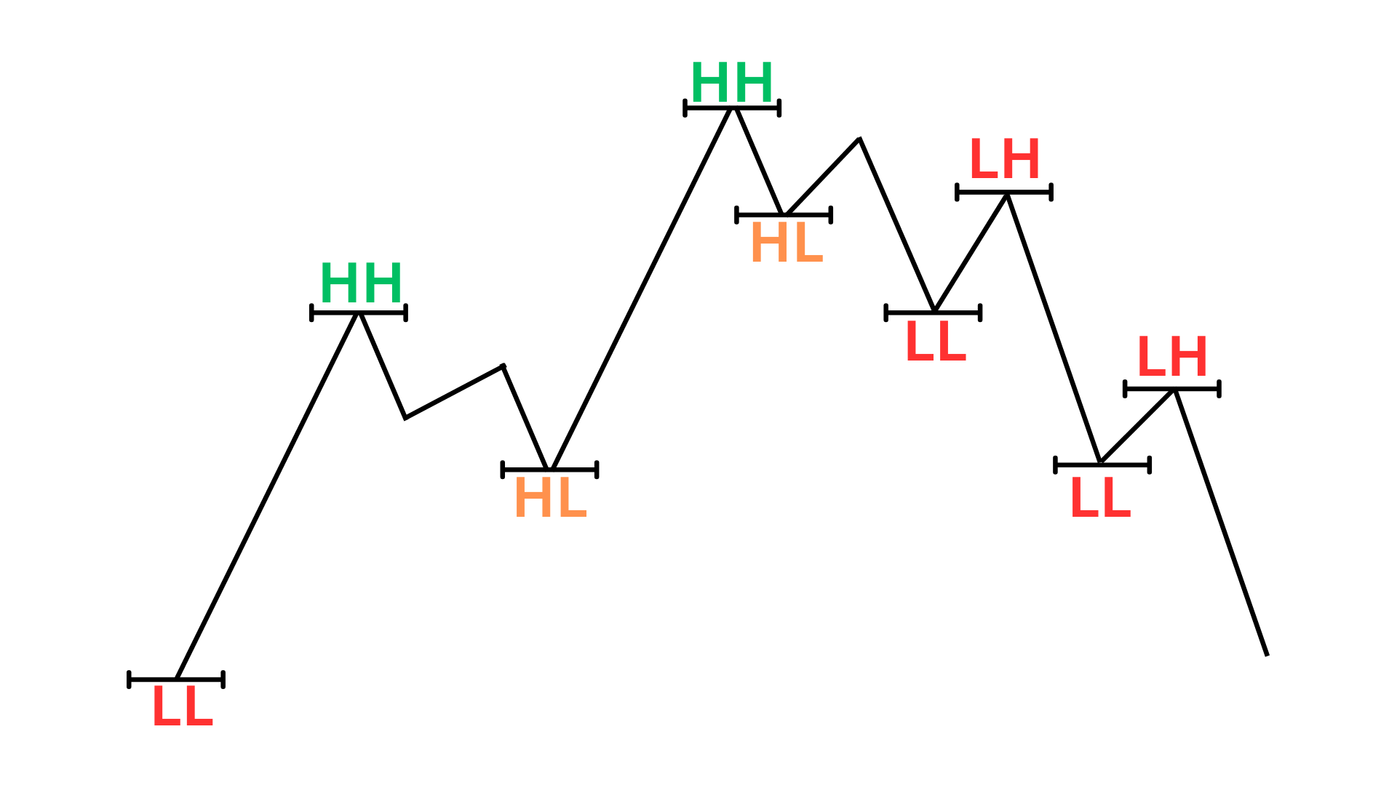
RSI Divergence
Graph
Moving Up
Moving Down
Higher Highs
Higher Lows
Lower Lows
Lower Highs

Slide 26
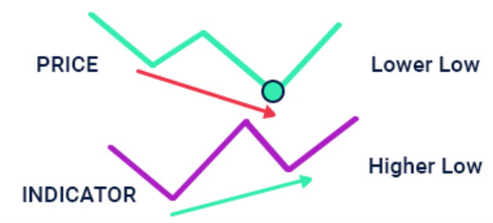
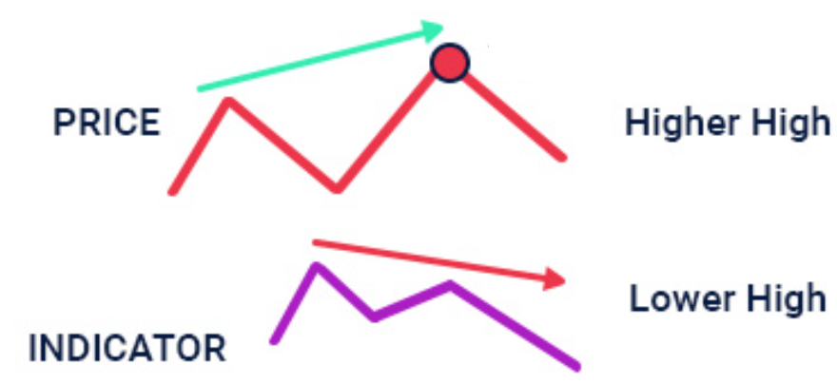
Regular RSI Divergence
Mostly for Trend Reversal
Bearish Regular Divergence:
Asset Value: Higher high
RSI: Lower high.
Identifies: Fake momentum/ Fake breakouts in the market.
Bullish Regular Divergence:
Asset Value: Lower lows
RSI: Higher Lows
Identifies: Shows possible bullish momentum.
.
Notes:
Bullish Regular Divergence:
Price goes down and reverses at some point but RSI reverses before price,

Slide 27
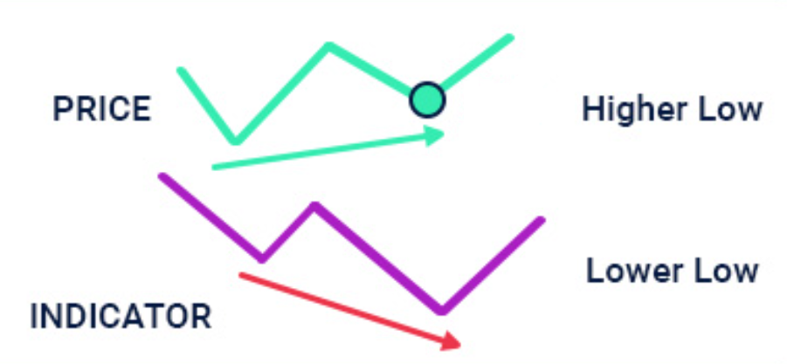
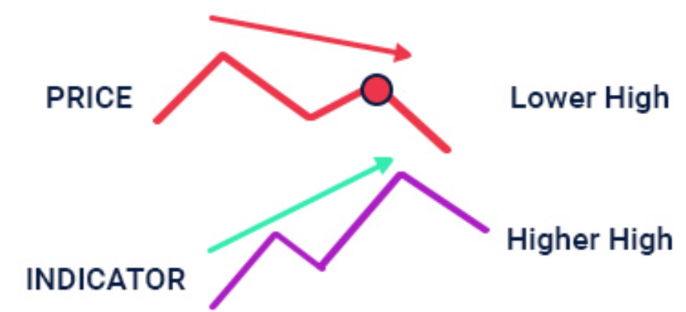
Hidden RSI Divergence
Mostly for Trend Continuation
Bearish Hidden Divergence:
Asset Value: Lower highs
RSI: Higher High.
Predicts: Bearish trend will continue.
Bullish Hidden Divergence:
Asset Value: Higher Low
RSI: Lower lows.
Predicts: Bullish trend will continue.
Notes:
Bearish Regular Divergence:
It is formed when our price is forming a higher high and our RSI is making a lower high.
Bearish Hidden Divergence:
Mostly forms in case of large trend formations.

Slide 28
RSI Divergence
 | Bearish Regular Divergence | Bullish Regular Divergence | Bearish Hidden Divergence | Bullish Hidden Divergence
Asset Value | Higher High | Lower Low | Lower High | Higher Low
RSI | Lower High | Higher Low | Higher High | Lower Low
Notes:
Bearish Regular Divergence:
It is formed when our price is forming a higher high and our RSI is making a lower high.
Bearish Hidden Divergence:
Mostly forms in case of large trend formations.

Slide 29
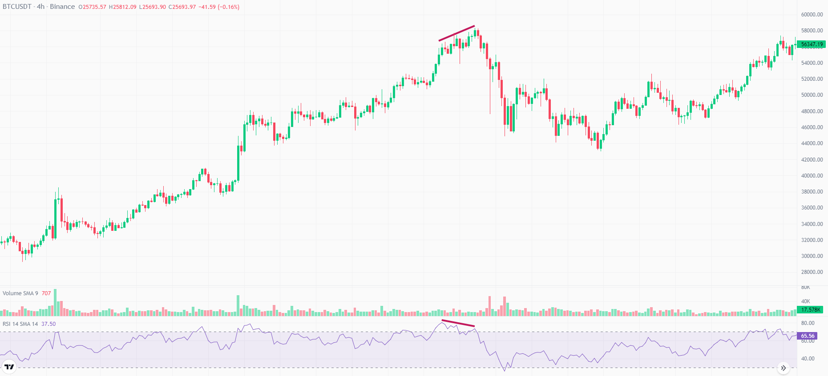
Bearish Regular RSI Divergence
Notes:
Bearish Regular Divergence:
It is formed when our price is forming a higher high and our RSI is making a lower high.

Slide 30
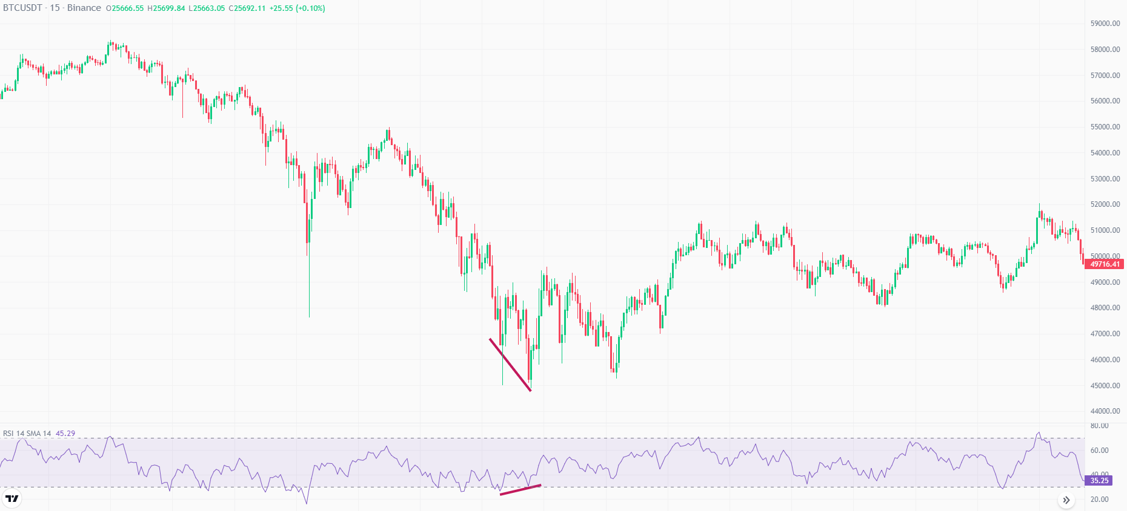
Bullish Regular RSI Divergence
Notes:
Bearish Regular Divergence:
It is formed when our price is forming a higher high and our RSI is making a lower high.
Bullish Regular Divergence:
It is formed when our price is forming a higher high and our RSI is making a lower high. It identifies fake momentum/ Fake breakouts in the market.

Slide 31
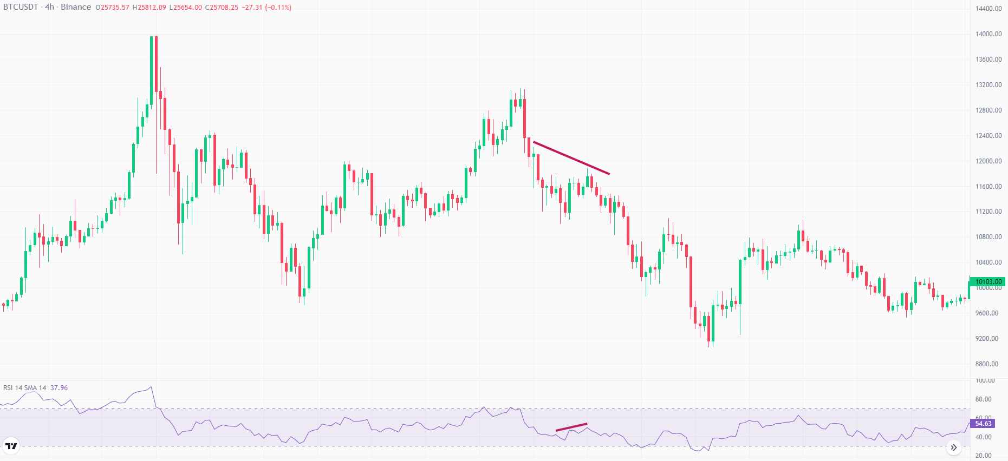
Bearish Hidden RSI Divergence
Notes:
Bearish Hidden Divergence:
Price was making lower highs, but RSI made Higher High. In this scenario price will go down / bearish trend will continue.
Mostly forms in case of large trend formations.

Slide 32
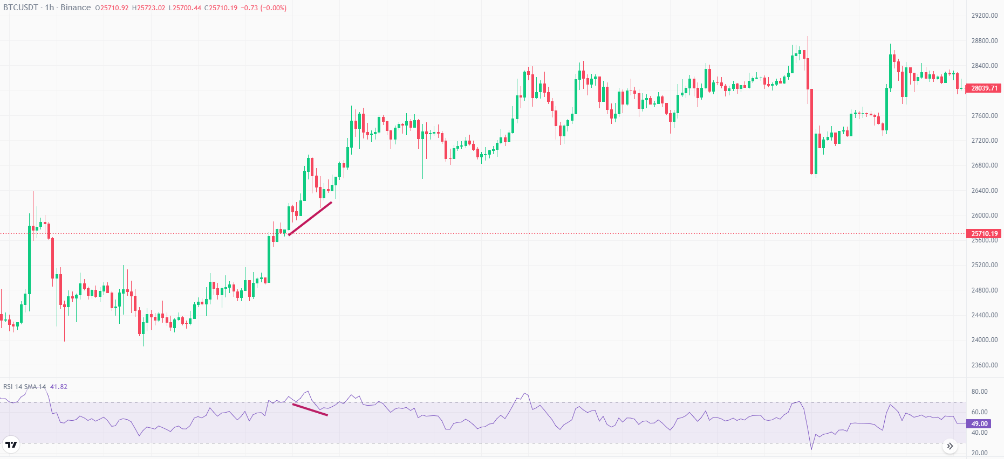
Bullish Hidden RSI Divergence
Notes:
Bearish Hidden Divergence:
Mostly forms in case of large trend formations.
Bullish Hidden Divergence:
Price is making a higher lows and RSI is making lower lows, the Bullish trend will continue.

Slide 33
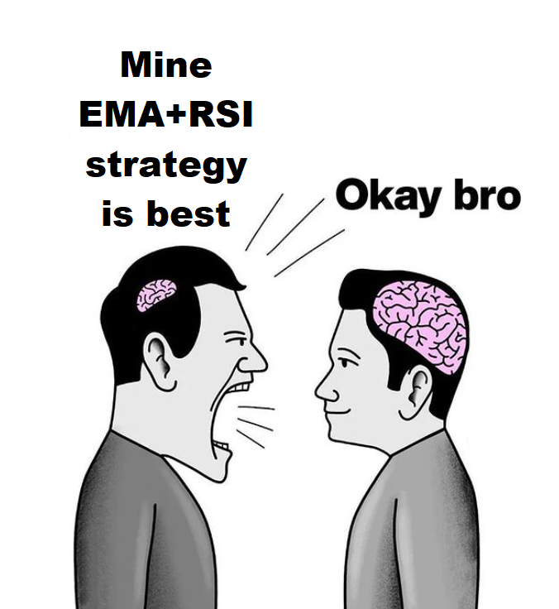

Slide 34
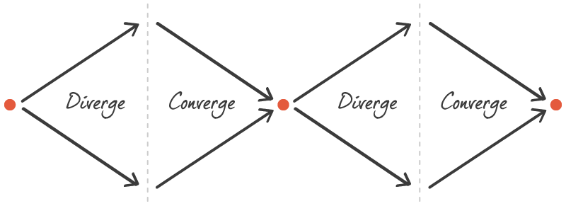
MACD
Moving Average Convergence and Divergence
Trend following Lagging momentum indicator
Significance:
Relationship between two moving averages of a security price.
Both Trend and momentum.
How it works?
Uses Convergence and Divergence.
Convergence: Part before intersection
Divergence: Part after intersection.
Problem:
EMA’s do their crossover late, and in that time entry opportunity vanishes.
We don’t know whether we are in the Entry side or the Exit side.

Slide 35
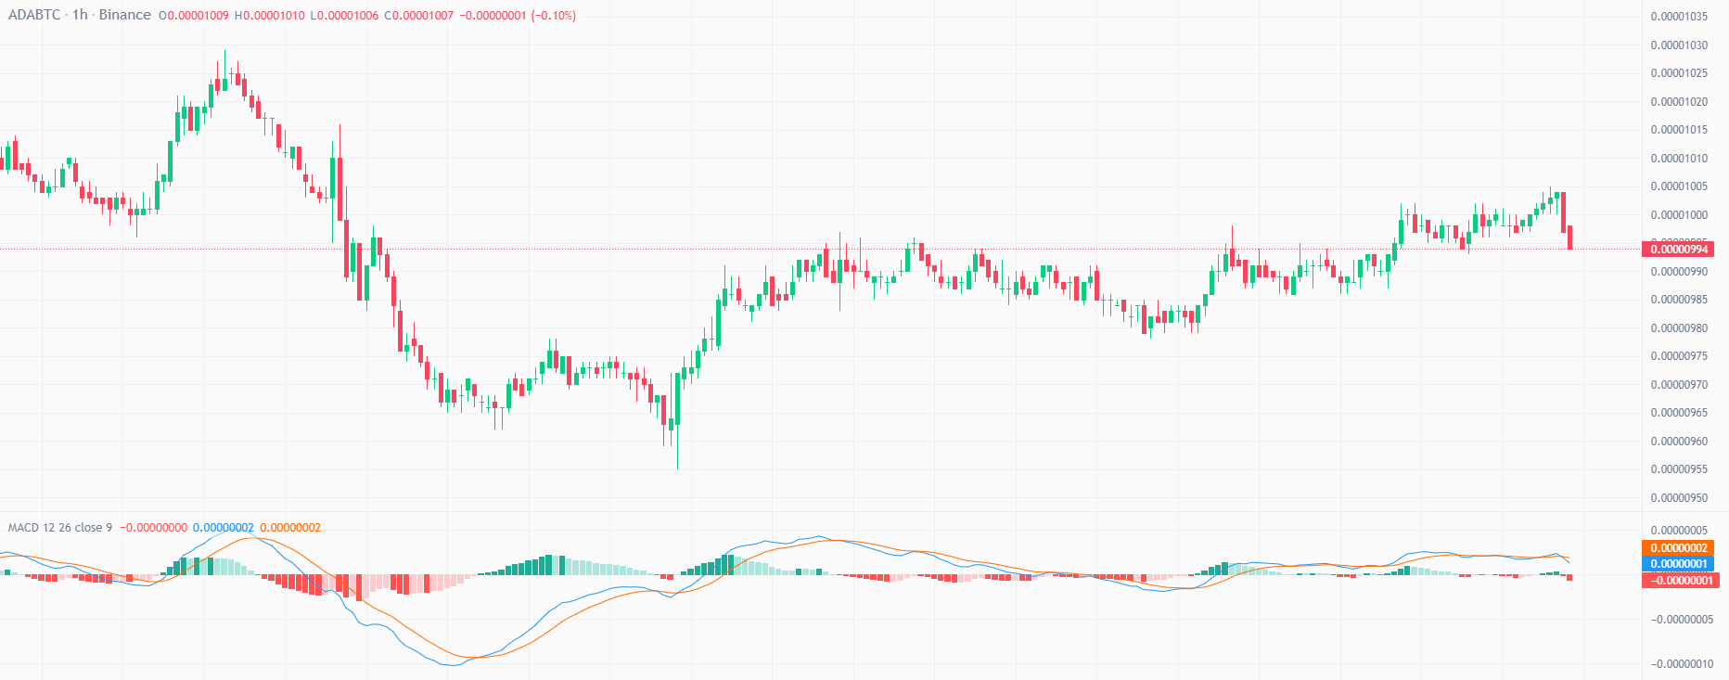
MACD
MACD line: 12 Period EMA - 26 Period EMA (Calculated by subtraction operation between 12 period moving average and 26 period moving average.)
Signal Line: 9 Period EMA
Base line: Line in between
Histogram: Difference between MACD line and signal line

Slide 36
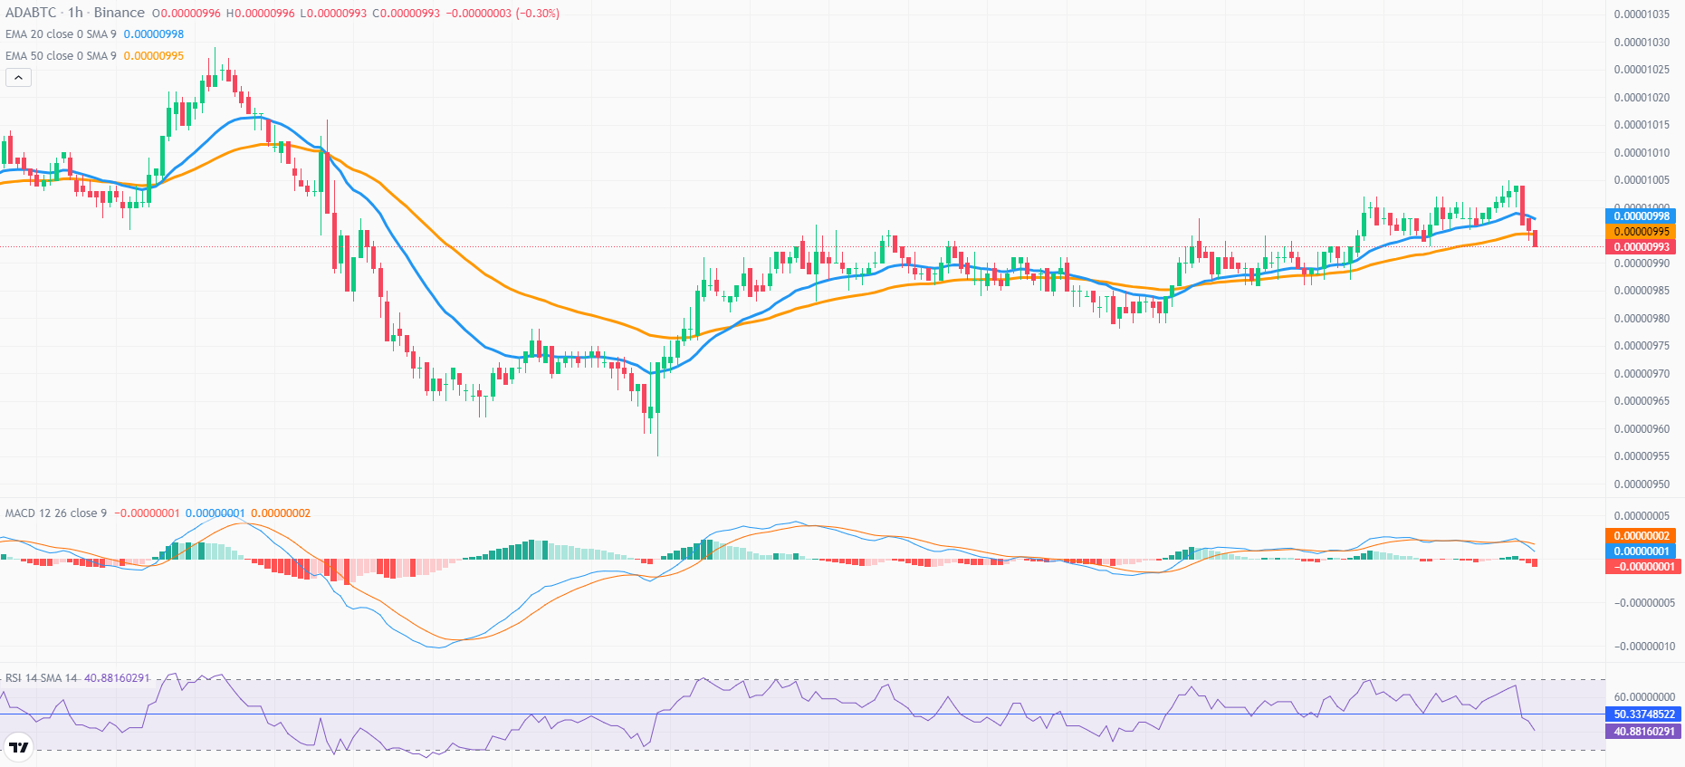
Is EMA effective or MACD?
Notes:
Getting a signal using MACD divergence beforehand.

Slide 37
Primary Methodologies
The more diverging these lines are, the more will be the spread factor of Histogram and the more momentum there will be in the market.
The side below the Base line would be the Entry Side and the side above it would be the Exit side.

Slide 38
Primary Methodologies

Slide 39
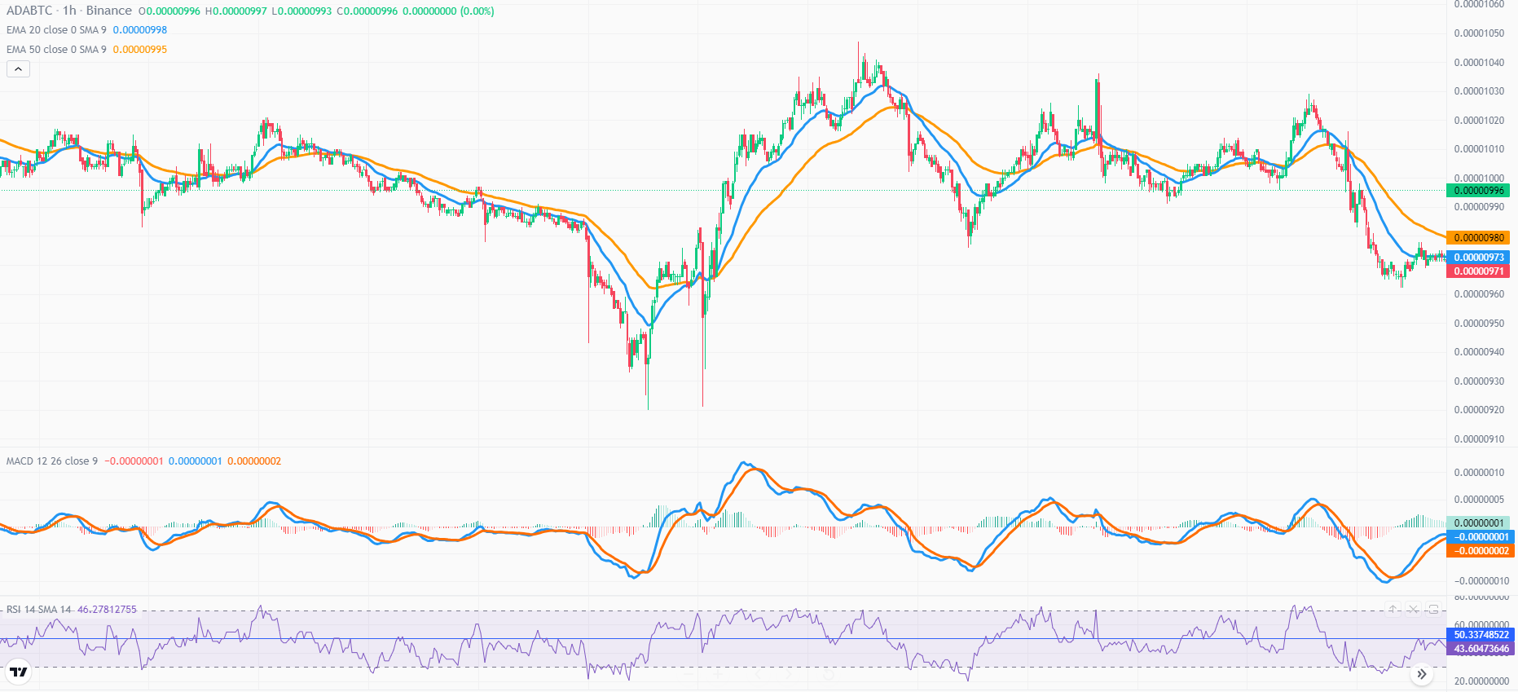
Secondary Methodologies
If the MACD line crosses the Baseline from below to above, the market can go in up trend and vice versa.
(There are chances, not certainty)
If MACD line crosses the Signal Line from below to above, then the market can go in uptrend.

Slide 40
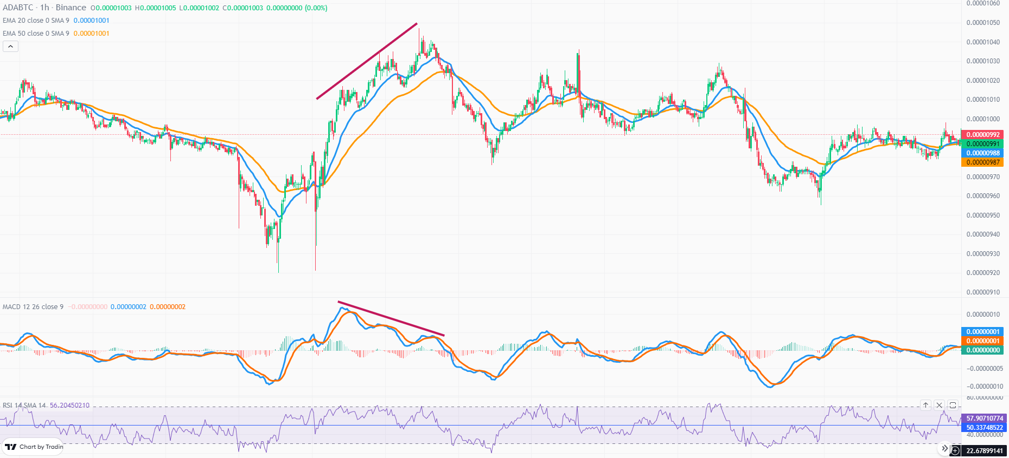
Secondary Methodologies
3) Divergence in MACD
We mostly use the regular divergence in MACD.
Bearish Divergence:
Price: Higher Highs
MACD: Lower Highs

Slide 41
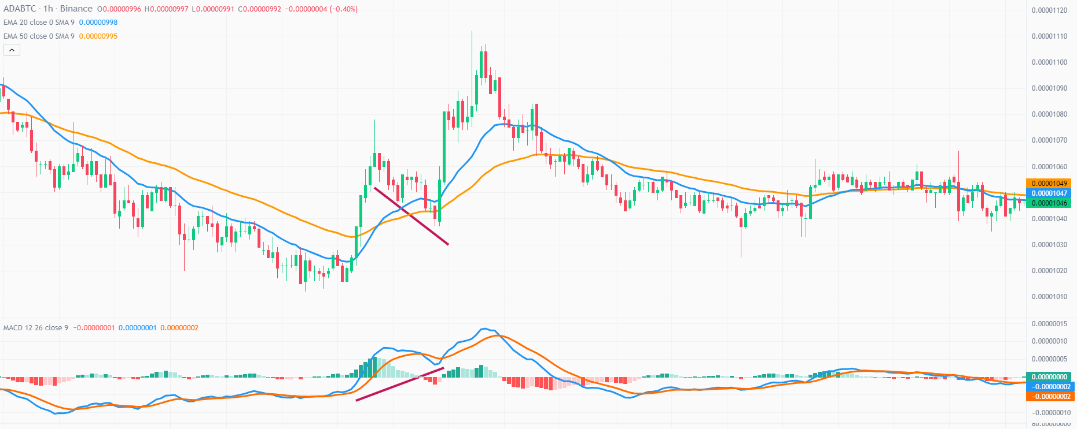
Secondary Methodologies
Bullish Divergence:
Price: Lower lows
MACD: Higher lows

Slide 42
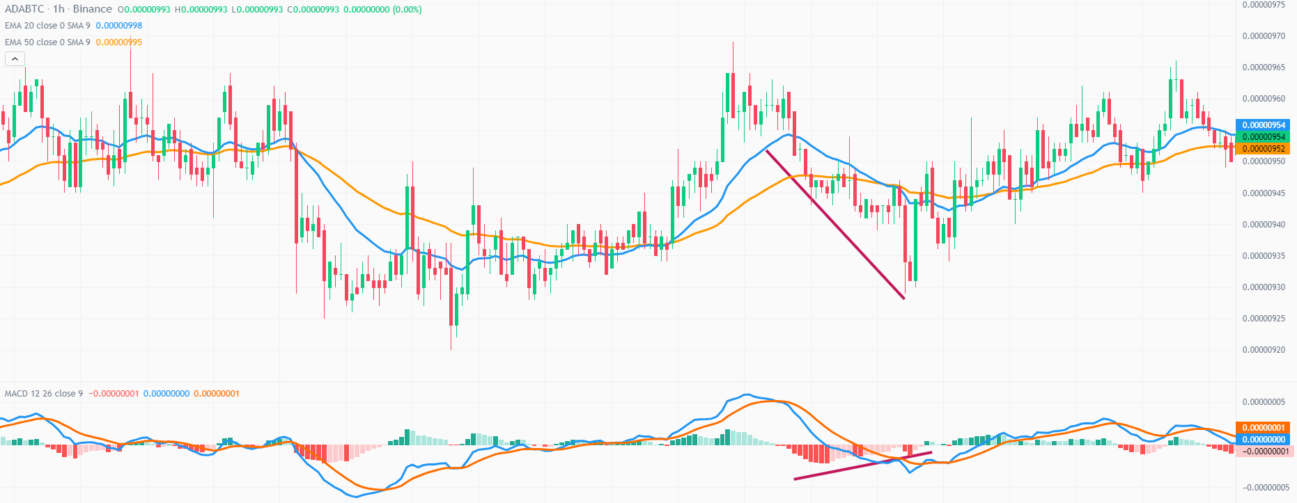
Secondary Methodologies
4) Divergence in Histogram
Asset Value is declining but Histogram is not expanding.
Notes:
Asset Value is declining but Histogram is not expanding→ Meaning It is reaching its support value.

Slide 43
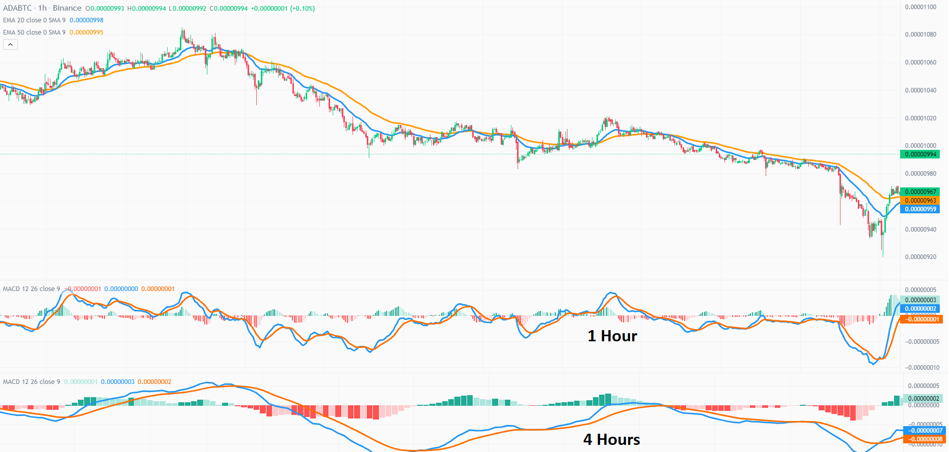
Secondary Methodologies
5) Comparing MACD at multiple timeframes

Slide 44
